Slide 1
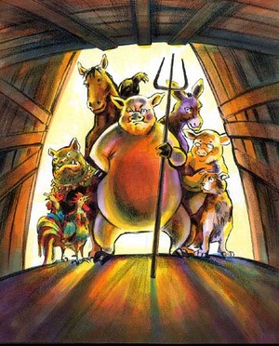
Animal Farm
Characters

Slide 2
Mr. Jones
Original owner of Manor Farm
Farm suffers under his incompetence
The last of the Czars (old government)

Slide 3
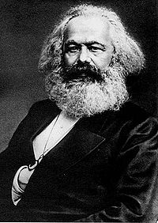
Old Major
Pure-bred pig
Grandfatherly
Philosopher of Change
INSPIRES the rebellion
Karl Marx Author: Communist Manifesto

Slide 4
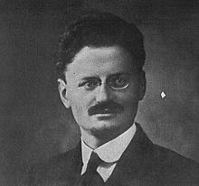
Snowball
Pig who wants to be a leader
Persuasive speaker
Argues with Napoleon
Trotsky

Slide 5
Napoleon
Betrays Animalism with his greed
Schemes behind the scenes to get power
Abuses trust of the animals with lies
Stalin

Slide 6
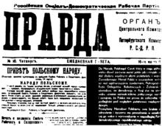
Squealer
A manipulative, persuasive pig
Makes lies sound logical
Pravda – a Russian newspaper that helped spread communist propaganda

Slide 7
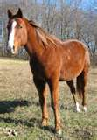
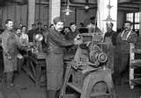
Boxer
A strong, faithful, hardworking horse
Worked to exhaustion, then murdered for money
A metaphor for the Boxer Rebellion in China which signaled the beginning of communism in China
Proletariat (lower class workers): loyal, hopeful

Slide 8
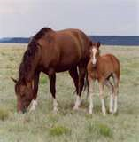
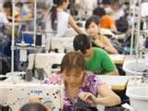
Clover
Motherly type horse who tried to comfort others
Proletariat (lower class workers): Russian women

Slide 9
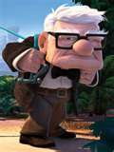
Benjamin
Old donkey who didn’t believe change would happen
Older, cynical generation of people

Slide 10
Moses
Clever raven who promises Sugarcandy Mountain
Does not work, just tells stories
Orwell’s view of the church
Marx’s view that “religion is the opiate of the people”

Slide 11
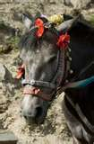

Mollie
A vain, flighty horse
Enjoys her perks (sugar and ribbons)
Doesn’t care much about politics
Middle class skilled workers who are accustomed to good pay and good benefits

Slide 12
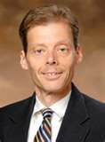
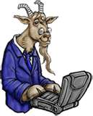
Muriel
Knowledgeable goat (reads to Clover)
Educated working class – takes no action though they oppose the new government

Slide 13


Farm Animals
Ordinary creatures who believed what they were told, forgot what they knew, and accepted whatever was happening through fear and inertia.
Russian people during time of U.S.S.R.

Slide 14
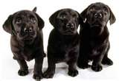

Dogs
Bluebell and Jesse give their puppies to Napoleon, who raises them to be his enforcers and priveleged bodyguards
KGB or bodyguards of Stalin

Slide 15
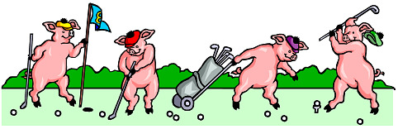
Pigs
Surround and support Napoleon
Live in luxury
Communist party loyalist – friends of Stalin

Slide 16
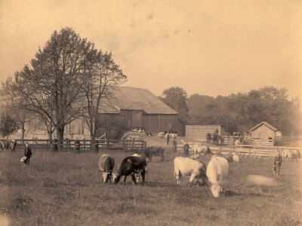
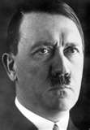
Mr. Frederick
Owner of Pinchfield Farm
Neighboring farmer
Proves to be untrustworthy: steals then attacks
Pinchfield is Germany
Frederick is Hitler

Slide 17
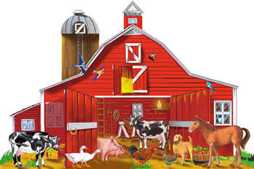
Mr. Pilkington
Owner of Foxwood Farm
Easygoing, gentleman farmer
Foxwood is England
Pilkington is Prime Minister Chamberlain

Slide 18
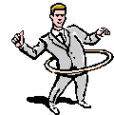
Mr. Whymper
Solicitor (lawyer) Napoleon hires to represent Animal Farm to humans
Ambassadors and PR men who made Russia look good to the world

Slide 19

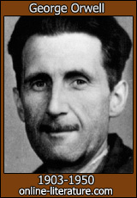

FYI
Communist Flag
Author of Animal Farm
Animal Farm Flag

Slide 20

The End

